Slide 1

Cardio good fitness project
By
Lavina Kunder

Slide 2
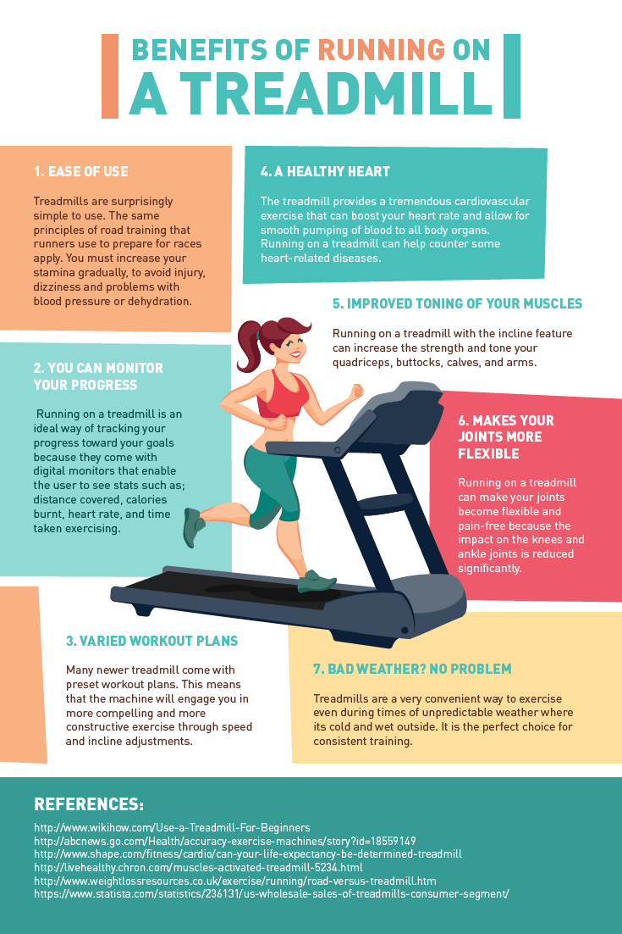
BACKGROUND
Cardio Exercises have many health benefits. They are great for weight loss, strengthening the heart, improving lung capacity, boosting energy and mental health, felicitating better sleep cycles and building a better immune system.
One of the best example of Indoor Cardio Exercise is Treadmill Running.

Slide 3
OBJECTIVE
Preliminary Data Analysis. Explore the dataset and practice extracting basic observations about the data.
Come up with a customer profile (characteristics of a customer) of the different products
Perform uni-variate and multi-variate analyses
Generate a set of insights and recommendations that will help the company in targeting new customers
Explore relationships between the different attributes of customers.

Slide 4
DATA INFORMATION
The data is for customers of the treadmill product(s) of a retail store called Cardio Good Fitness. It contains the following variables:
Name | Type | Information
Product | Object (String) | 3 Products
Age | Integer | Range from 18 to 50 years
Gender | Object (String) | Male / Female
Education | Integer | Range from 12 to 21 years
Marital Status | Object (String) | Single or Partnered
Usage | Integer | Range from 2 to 7 times / week
Fitness | Integer | Range from Level 1 to 5
Income | Integer | Ranges from 29562 to 104581
Miles | Integer | Ranges from 21 to 360 miles
There are a 180 rows and 9 columns
There are no missing or duplicated values

Slide 5
UNIVARIATE ANALYSIS

Slide 6
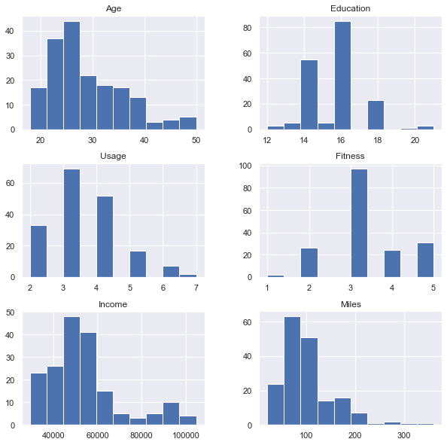
Histogram Plots
Histogram Plots of the various numerical Attributes present in the given Dataset. It shows the frequency of each element within the attribute.

Slide 7
Observations
Age has the maximum concentration from 20 to 30 years, implying that most customers are in that age range.
Most customers have an education of 16 years
More than one - third of the customers plan on using the treadmill upto 3 times a week
More than half the customers self rate themselves at 3 for fitness (Average Fitness)
40,000 to 60,000 is the income range of most of the customers with very few earning in the range of 80,000 to 100,000
Most Customers plan to run in the range of 0 - 100 miles with less than 20 customers planning to run in the range 200 - 300

Slide 8
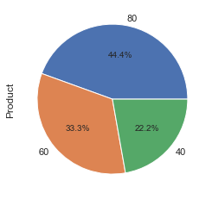
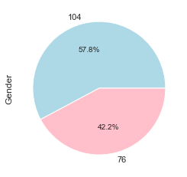
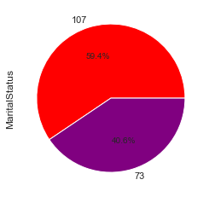
Variable Analysis
From this graph we are able to understand that most customers prefer the TM195 Model (80 customers) of the treadmill followed by the TM498 Model (60 customers) and lastly, the TM798 Model (40 customers)
This graph shows the customer buying the Treadmills from Cardio Good Fitness are more likely to be men than women with 104 customers being men and only 76 being women.
This graph shows the customer buying the Treadmills from Cardio Good Fitness are more likely to be Partnered (107 customers) than Single (73 Customers)

Slide 9
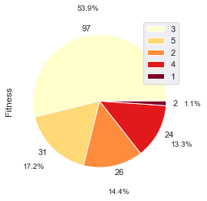
Variable Analysis
From this graph, we are able to understand that most of the customers (almost 50%) self rate as moderately fit with a very small percent of the population self rate as being very unfit. Most of the customers tend to be above average in fitness.

Slide 10
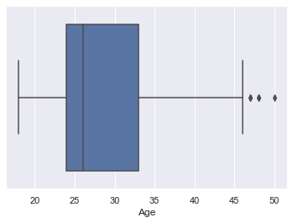
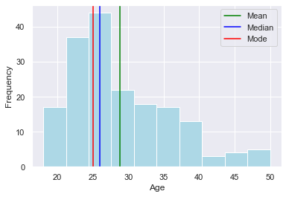
Age
By these graphs, we come to know that a large number of customers are aged in the range of 20 - 30. There are very few customers in the age range of 40 - 45. The Age Data is also right skewed.

Slide 11
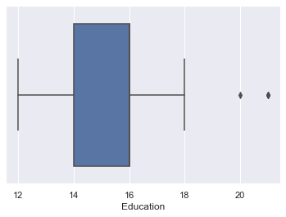
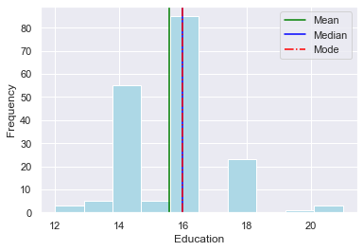
Education
Most Customer's Education Years are in the range of 14 - 16 with 16 years having the highest concentration. There are very few people with over 20 years of education and are displyed as outliers. The Median and the Mode overlap at 16 years.

Slide 12

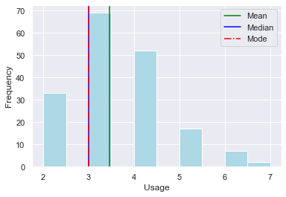
Usage Distribution
Most customers plan on using the treadmill 3 times a week. The mode and the median overlap at 3 times / week. Very few customers plan on using the treadmill more than 5 times a week and are displyed as outliers on the boxplot.

Slide 13
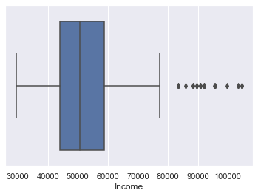
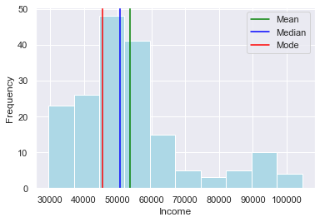
Income Distribution
Most customers have an income range of 50,000 to 60,000.

Slide 14
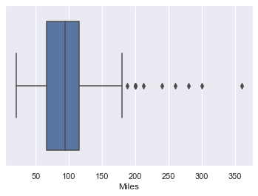
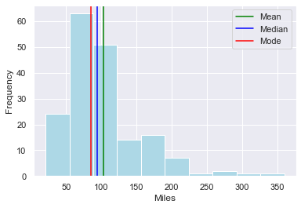
Miles
Most customers expect to run in the range of 50 - 100 miles. There are quite a few outliers in this case due to the fact that very few wish to run almost 200 - 300 miles.

Slide 15
BIVARIATE ANALYSIS

Slide 16
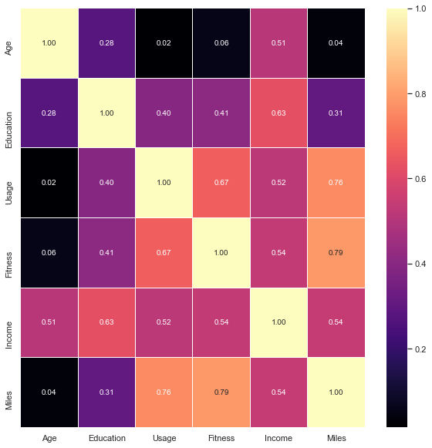
Correlation Heat Map
This Heat Map shows the correlation between the individual attributes. With this we can draw the following inferences :
1) Miles a customer expects to run is dependant on their Usage and Fitness
2) The Income of a customer is highly dependant on their Education and Age
3) There does not seem to be a strong relationship between Age and other customer statistics except for Income
4) Income of a customer plays a very important role in the other stats for customers buying treadmills.

Slide 17
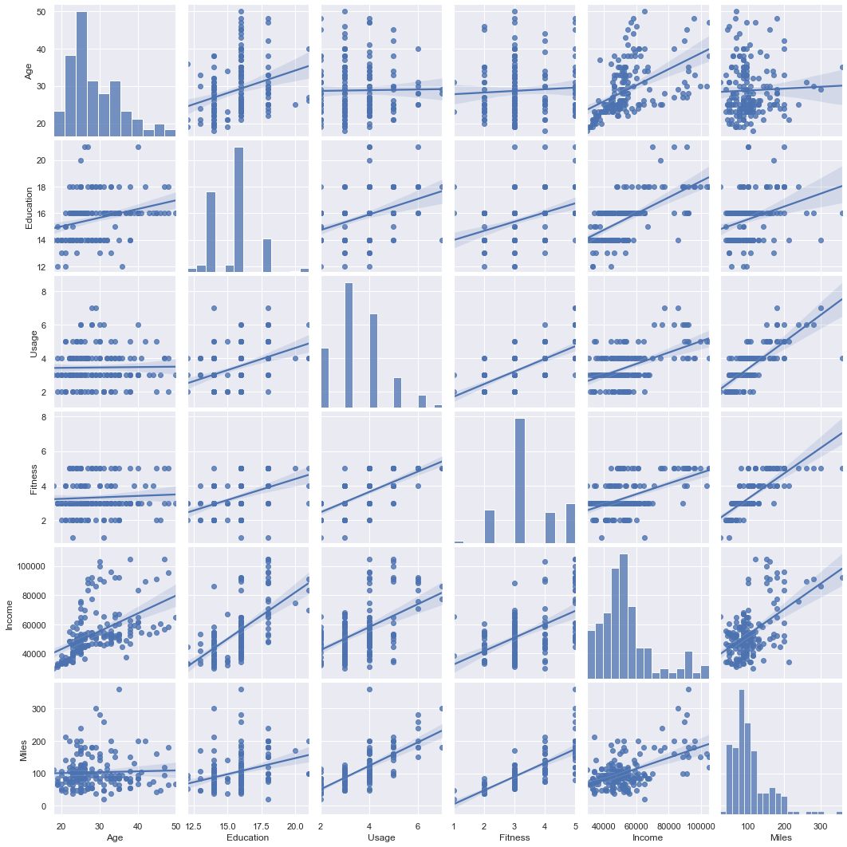
Pair Plot

Slide 18
Pair Plot

Slide 19
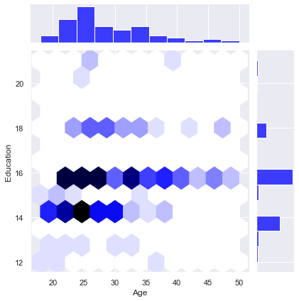
Joint Plot of Age and Education
OBSERVATIONS
Customers in the Age Range of 20 to 30 years mostly have 14 - 16 years of education.
Most customers aged 25 have 14 years of experience.
There are very few people with 18 years of education in the age range 25 to 35 years.
16 years of education is most common between people of different ages.

Slide 20
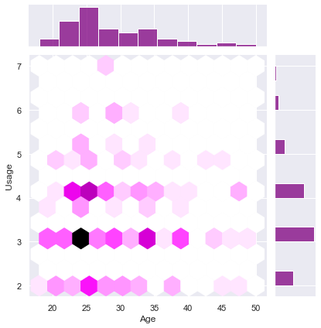
Joint Plot of Age and Usage
OBSERVATIONS
Most customers in the age range 20 to 40 plan to use the treadmill 3 times a week
A slightly lower concentration of customers aged 22/23 to 27/28 plan to use the treadmill 4 times a week.

Slide 21
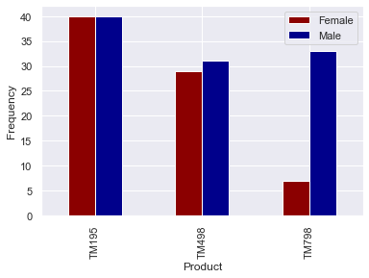
Relationship of Product and Gender
OBSERVATIONS
TM195 is equally preferred by Men and Women
TM 498 is slightly preferred more by Men than Women
Very few Women prefer the TM798 and is mostly preferred by Men.

Slide 22
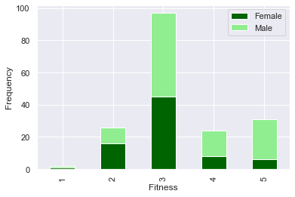
Relationship of Fitness and Gender
OBSERVATIONS
FITNESS LEVEL 1 : Has very few customers in this fitness level. Any Customers in this level are equally split between Men and Women
FITNESS LEVEL 2 : With almost 30 customers, there are more Women than Men in this Fitness Level.
FITNESS LEVEL 3 : Has the highest number of customers, almost touching 100. Men and Women are more or less equally distributed in this Level
FITNESS LEVEL 4 : With only 20 to 25 customers in this level, there are more Men than Women in this Fitness Level
FITNESS LEVEL 5 : Mostly dominated by Men, this level has almost 30 customers.
From this we can understand:
Male Customers generally rank themselves higher in the fitness scale than women

Slide 23
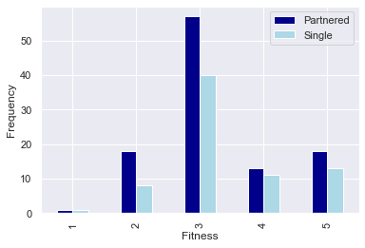
Relationship of Fitness and Marital Status
OBSERVATIONS
FITNESS LEVEL 1 : Has very few customers in this fitness level. Any Customers in this level are equally split between Partnered and Single
FITNESS LEVEL 2 : Partnered Customers are almost double the number of the Single Customers in this Level
FITNESS LEVEL 3 : Has the highest number of customers, almost touching 100. Although, there are more partnered customers than single ones
FITNESS LEVEL 4 and 5 : With very few customers, in both these levels, they are both dominated by Partnered customers.
From this we can understand:
For each Fitness level, customers are more likely to be Partnered than Single

Slide 24
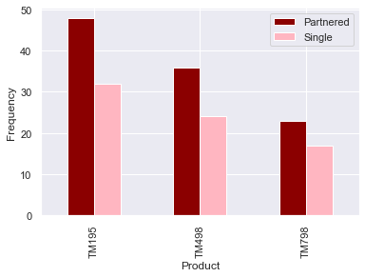
Relationship of Product and Marital Status
OBSERVATIONS
All the models of the treadmill have more Partnered customers than Single Ones

Slide 25
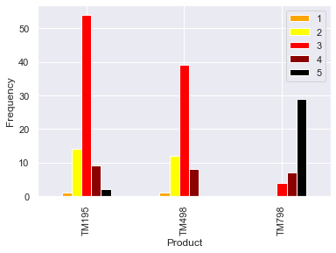
Relationship of Product and Fitness
OBSERVATIONS
TM195 Has the most customers with most self rating themselves at fitness level 3. There are very few at Fitness Level 1 and 5.
TM498 shows characteristics similar to TM195 but has no customers at fitness level 5
TM798 has no customers at fitness level 1 and 2 with most customers concentrated at self identifying at fitness level 5

Slide 26
MULTIVARIATE ANALYSIS

Slide 27
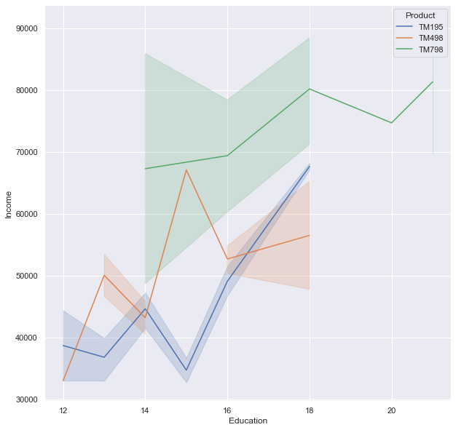
Relationship of Education, Income and Product
OBSERVATIONS
Customers with lower income (30,000 to 50,000) and years of education ranging from 12 to 18 prefer the TM195 Treadmill.
Customers with slightly higher incomes (50,00 to 70,000) and years of education ranging from 12 to 18 prefer the TM498 Treadmill.
Customers with high income (60,000 to 80,000+) and years of education ranging from (14 to 20+) prefer the TM798 Treadmill.
From this we can understand:
The TM798 Treadmill is the most expensive followed by the TM498 and lastly the TM195
Education and Income are directly proportional. (Higher the Education, higher the Income)
Customers with higher income and more years of education prefer the the TM798 model. Customers with mediocre income prefer the TM498 and those with even lower income prefer the TM195

Slide 28
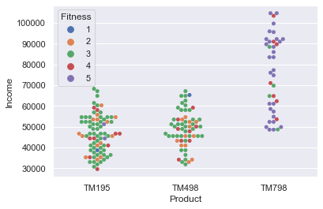
Relationship of Fitness, Income and Product
OBSERVATIONS
Customers with Fitness Levels 1, 2 and 3 mostly prefer TM195 and TM 498.
Customers with Fitness Levels 4 and 5 mostly prefer TM798. These Customers also have a much higher income as compared to the customers in other fitness levels

Slide 29
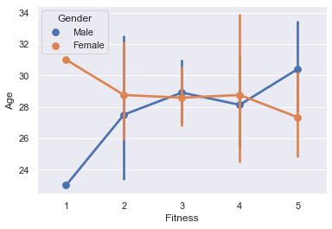
Relationship of Fitness, Age and Gender
OBSERVATIONS
Men of ages 26 to 30 mostly range from 2 to 4 in their fitness levels.
Women also display the same characteristics.
For Fitness Level 1 (Very Unfit); Women in this category are usually older whereas Men in this category are very young.
For Fitness Level 5 (Very Fit); Men in this category are usually older whereas Women in this category are comparatively younger.
From this we can understand:
FOR MEN : As the Age increases; the Fitness Level also increases.
FOR WOMEN : As the Age increases; the Fitness Level decreases.

Slide 30
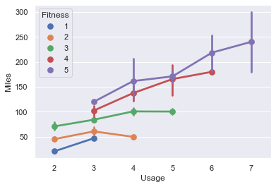
Relationship of Fitness, Usage and Miles
OBSERVATIONS
Customers that self rate at fitness level 1, mostly plan on using the treadmill 2 to 3 times per week expecting to run 50 miles
Customers that self rate at fitness level 2, mostly plan on using the treadmill 2 to 4 times per week expecting to run almost 60 miles
Usage rises to the range 2 to 5 for fitness level 3 with expected miles also rising to the range of 60 to 100.
At Fitness Level 4, customers plan on using the treadmill 3 to 6 times a week with expected miles rising to the range 100 to 180
Fitness Level 5 ranks the highest usage of range 3 to 7 times a week with expected miles ranging from 100 to 250+
From this we can understand:
Usage and Miles are directly proportional (As Usage increases, Miles increases and vice versa)
Fitness Level also increases with rise in Usage per week and Miles expected to run.

Slide 31
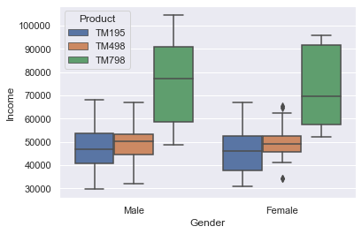
Relationship of Gender, Income and Product
OBSERVATIONS
According to the Model of treadmills preferred, we can say that :
TM 195 : Income ranges from 30,000 to 70,000 for both men and women.
TM 498 : Income ranges from 32,000 to 68,000 for men and 42,000 to 62,000 for women (with outliers present)
TM 798 : Income ranges from 49,000 to 100,000+ for men and 53,000 to 95,000 for women.
From this we can understand:
People with more income prefer TM798. This makes it probable that it is the most expensive.
Men earn more than Women
More Men prefer the TM798 than Women

Slide 32
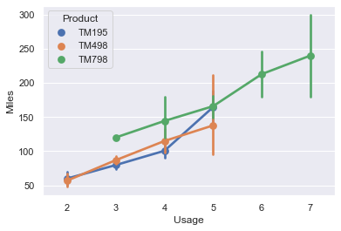
Relationship of Usage, Miles and Product
OBSERVATIONS
For the Usage range of 3 to 4; customers with TM498 plan to run more miles(90-140) than the customers with TM195 (80 - 100).
For the Usage range of 4 to 5; customers with TM195 have a sharp incline in the miles expected to run (100 - 160 miles) whereas customers with TM498 increase at the same rate (120 - 140 miles)
For the same usage; customers with TM798 plan to run more miles than those customers with TM195 and TM 498
From this we can understand:
Customers with TM798, run the most miles as well as use it more frequently.
Customers with TM 498 run more miles than customers with TM 195 when they use it for 3 - 4 times a week
For 4 - 5 times a week; customers with TM 195 run more miles than customers with TM 498

Slide 33
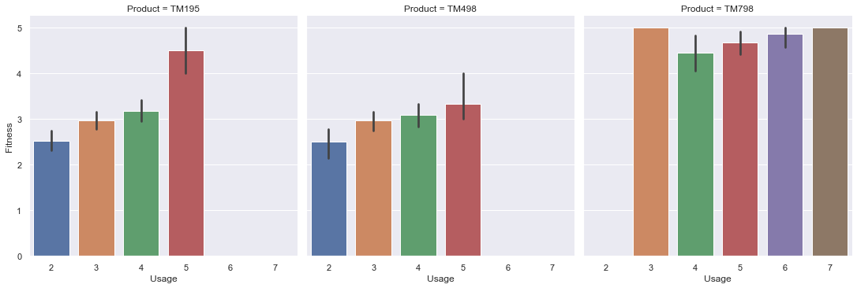
Relationship of Usage, Fitness and Product
OBSERVATIONS
For TM195 and TM498; the Usage is similar for customers in fitness level 2, 3 and 4. Although customers that are very unfit (fitness level 1) tend to use the TM195 model more per week than those customers using the TM498 model.
No customer that prefers model TM498 self rates themselves at fitness level 5 (very fit)
No customer that prefers model TM798 self rates themselves at fitness level 1 and 2 (very unfit and unfit)
Customers who prefer the TM195; expect to use the treadmill 3 to 4 times a week to maintain their self rated fitness level of 3.
Customers who self rate at fitness levels 3 and higher, use the treadmill 3 or more times a week
Customer of TM498 limit usage to 5 times a week with the highest self rated fitness level being 4

Slide 34
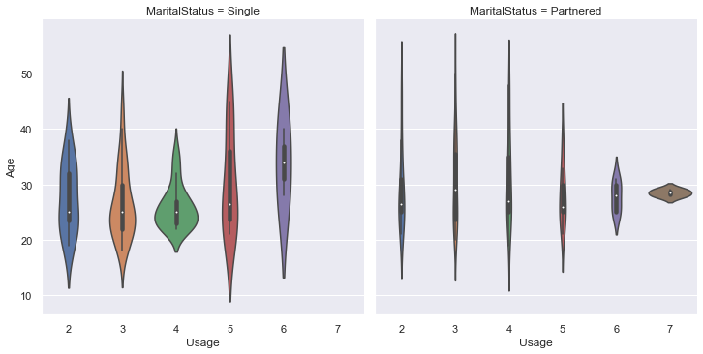
Relationship of Usage, Age and Marital Status
OBSERVATIONS
Single people tend to use the treadmill more than partnered people for all expected number of uses in a week.
Single customers do not use the treadmill 7 times a week at all.
Partnered customers have a bigger age range than single customers

Slide 35
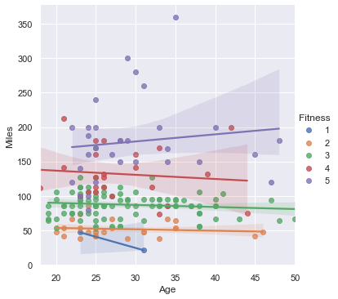
Relationship of Miles, Age and Fitness
OBSERVATIONS
FITNESS LEVEL 1 : As age increases; Miles expected to run decreases.
FITNESS LEVEL 2, 3 : As Age increases; miles expected to run has a very small and negligible decline
FITNESS LEVEL 4 : As Age increases, there is a minor but noticeable decline in expected miles run
FITNESS LEVEL 5 : As Age increases, Miles expected to run also increases.
From this we can understand:
As Age increases, those who self identify at fitness level 1,2, 3 and 4 have a decline in miles that they run except for those who identify as level 5 whose expected miles increase.

Slide 36
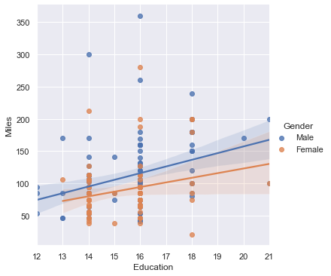
Relationship of Miles, Education and Gender
OBSERVATIONS
Males run more miles than Females
Men and Women roughly have the same years of Education
Higher the Education, higher the Miles expected to run.

Slide 37
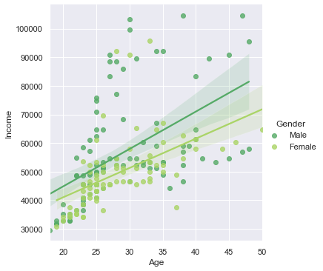
Relationship of Income, Age and Gender
OBSERVATIONS
For both Men and Women; as Age increases, the income also increases.

Slide 38
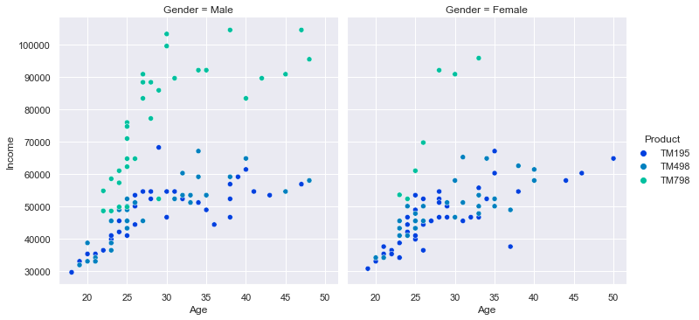
Relationship of Income, Age, Product and Gender
OBSERVATIONS
TM798 is more preferred by men with higher income.
Men of higher age prefer both TM798 as well as TM195 whereas women of higher age prefer the TM195 only
Men of age 20 to 35 have bought more treadmills than women of the same age.

Slide 39
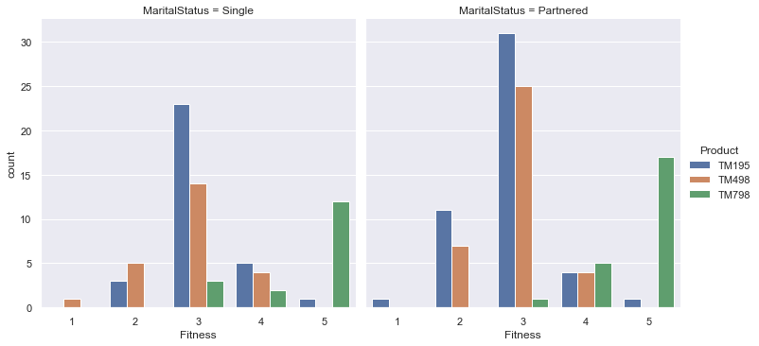
Relationship of Marital Status, Fitness and Product
OBSERVATIONS
FITNESS LEVEL 1 - Single customers prefer TM498 whereas partnered customers prefer TM195
FITNESS LEVEL 2 - Single customers prefer TM498 more than TM195 and vice versa for Partnered.
FITNESS LEVEL 3 - TM195 is preferred most followed by TM498 and then TM195; however Partnered customers have bought significantly more number of treadmills
FITNESS LEVEL 4 - Single customers prefer TM195 the most followed by TM498 and TM798. Partnered customers prefer TM798 the most followed by TM 195 and TM498 with equal preference
FITNESS LEVEL 5 - Both Single and Partnered prefer TM798 followed by TM 195
From this we can understand:
As Fitness rises, TM798 is preferred.
Partnered customers buy more treadmills than Single ones

Slide 40
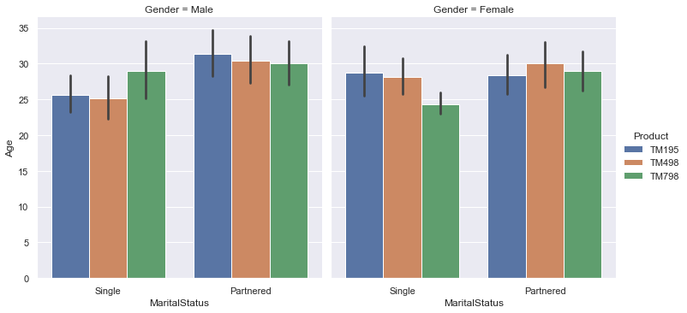
Relationship of Marital Status, Age, Gender and Product
OBSERVATIONS
Partnered Males and Single Females exhibit the same behaviour. They prefer the TM798 at first and as age rises they prefer TM498 and then TM195

Slide 41
RECOMMENDATIONS
TM798 can be marketed targeting those people who have higher income and more education. It can be branded as a luxury product with better benefits.
TM195 and TM498 can be marketed for the middle and lower class. These cost less and are more suited for them.
Men can also be targeted more than women as they seem to run more and also have higher income.
Depending on different usage, different market strategies can be developed
TM798 can be marketed to people with better Fitness Levels
Since more customers are partnered, we can launch special strategies targeting couples more for buying the treadmills

Slide 42
RECOMMENDATIONS
FOR MEN : As the Age increases; the Fitness Level also increases. FOR WOMEN : As the Age increases; the Fitness Level decreases. Therefore, they can be targeted to switch to other models of the treadmill to suit their needs better

